Slide 1

An Introduction to Classes in PowerShell

Slide 2
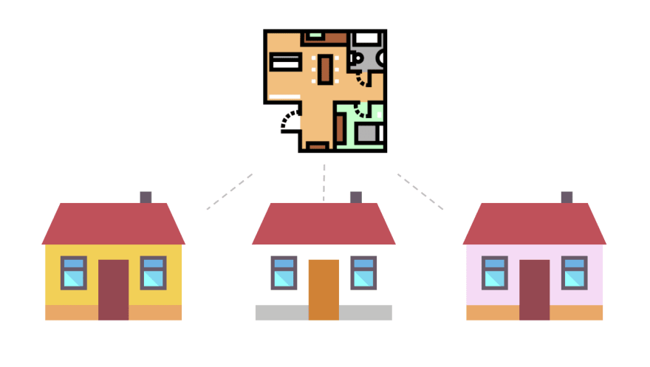
What are classes?

Slide 3
Properties
Describes an object
Methods
Actions an object can take
Constructors
How an object is made

Slide 4
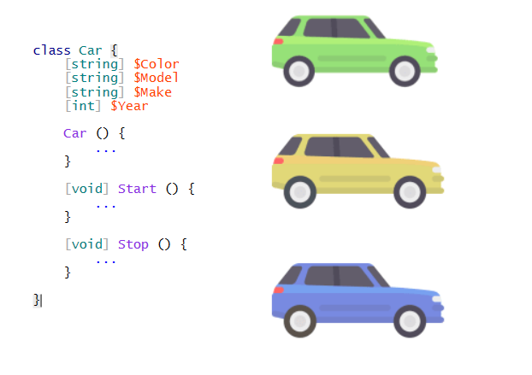

Slide 5
Nobody likes slide decks, just get to the code already!

